Slide 1
About the course
We are always trying to improve the course so would be very happy to hear any suggestions. The course has been run by using new method Project Based Learning (PBL). We remind you that:
The course is run in its current configuration for the first time; the number of contact face-to-face hours has been dramatically increased. With the minimum required 12x3=36 hrs, we actually delivered more hours than this minimum: 4x3 + 8x4 = 12+32 = 44 hrs.
(2) Our qualified team has designed a modern and relevant context for this Course.
Notes:
Note: in this series I am going to cover everything to know about NN if you do not have no background required.

Slide 2
About the course
(3) We have presented universal techniques to solve variety of problems; at the same time representative examples were provided from a range of engineering applications (mechanical, automotive, electrical, environmental engineering, etc.).
(4) We have introduced computer-based hand-on tutorials and involved the team of best expert tutors.
(5) We worked hard to take into account student's feedback and listen to the students suggestions.
(6) We value their feedback and CES is important to us.
(7) Please if you have any questions and issues contact your tutorial directly and cc Hamid ( hamid.khayyam@rmit.edu.au ) as well.
Notes:
Note: in this series I am going to cover everything to know about NN if you do not have no background required.

Slide 3

CES
10 Minutes to complete your feedback and CES please!!
Notes:
Note: in this series I am going to cover everything to know about NN if you do not have no background required.

Slide 4
Machine Learning Practical Revision (ANN, SVM, NLR)
Lecturer:
Dr Hamid Khayyam (Australia)
Email: hamid.khayyam@rmit.edu.au

Slide 5
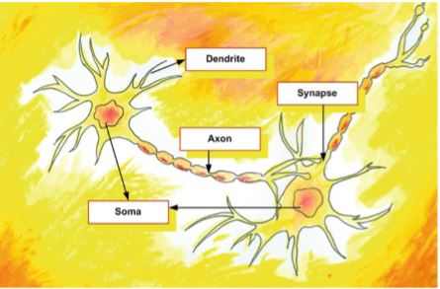
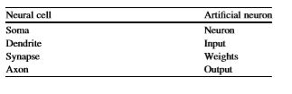
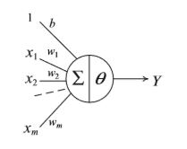

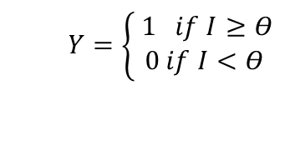

Artificial Neural Network (ANN)
$Y=\left\{\begin{aligned} 1 if I≥Θ \\ 0 if I<Θ\end{aligned}\right.$
$$I=W∗X+b$$
The mathematical relation of the functional process of an artificial neuron

Slide 6
The Steps of an application of ANN
Data pre-processing (check for missing data ,standardization)
Selecting network architecture
net = feedforwardnet();
Network training
[net,tr]= train(net,inputs,targets);
Simulation (validation)
a =net (inputs);
Performance(Post-processing)
MSE: Mean squared error performance function.
RMSE: Root Mean squared error performance function
R: Coefficient of correlation.

Slide 7
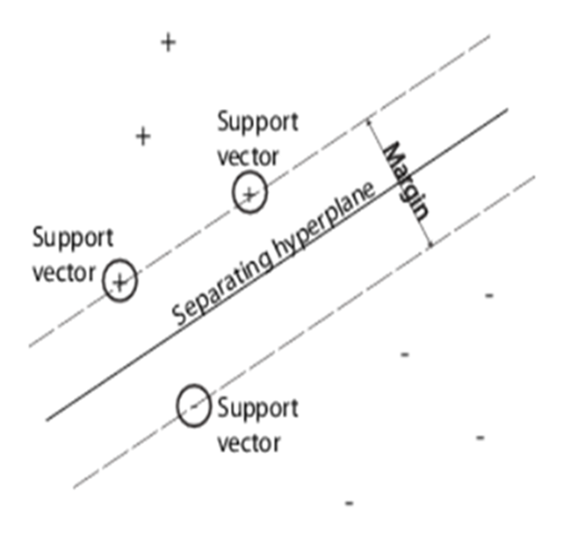
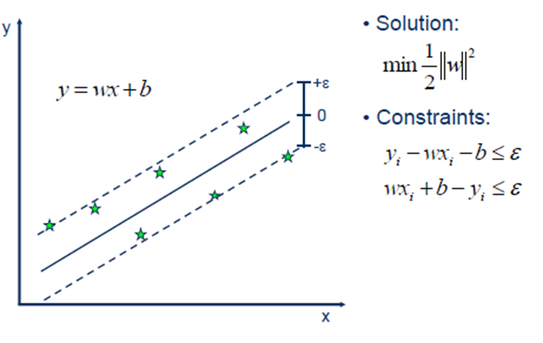

Support Vector Machine (SVM):
Classification in SVM
+ : data points of type 1
– : data points of type –1
Regression in SVM (SVR)
The data points nearest to the hyperplane
$ε$: Margin of tolerance

Slide 8

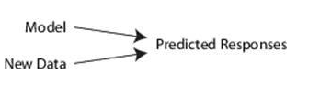
Steps of An Application of SVR
Data pre-processing (check for missing data ,standardization)
Model development and training
Mdl = fitrsvm( X, Y) (Regression)
3. Simulation (prediction )
Y_predicted= predict(Mdl,X) (Regression) %Y_predicted is the predicted responses
4. Post-processing
MSE,RMSE,R (Regression)

Slide 9
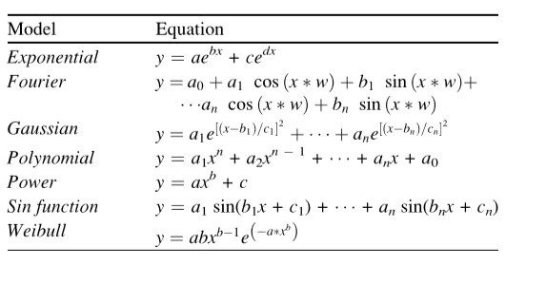
Nonlinear Regression (NLR):
A term used for all a wide range of regression models which all present a
nonlinear relationship between input and output .
Conventional nonlinear regression functions

Slide 10
Steps of An Application of NLR
Data pre-processing (check for missing data ,standardization)
Define the model function and coefficients initiation
Model development and training
mdl = fitnlm(x,t,fun,beta);
Simulation (prediction )
Y_predicted= predict(Mdl,X) ;
Post-processing
MSE, RMSE, R

Slide 11
Example of ANN (1) :
%prediction of Torque based on fuel rate and speed
clear;clc;
Filename='DataEngine.xlsx';
Sheetread='Training';
Input1='A1:B1194';
output1='C1:C1194';
Input=xlsread(Filename,Sheetread,Input1);
Target=xlsread(Filename,Sheetread,output1 );
x=Input;
t=Target;
Sheetread1='Newdata';
Input2='A1:B3';
Target2 ='C1:C3';
Inputnew=xlsread(Filename,Sheetread1,Input2);
Targetnew=xlsread(Filename,Sheetread1,Target2 );

Slide 12
Example of ANN (1): (cont.)
xnew=Inputnew;
tnew=Targetnew;
x=Input';
t=Target';
xnew=Inputnew';
tnew=Targetnew';
trainFcn = 'trainlm'; hiddenLayerSize = 10;
net = fitnet(hiddenLayerSize,trainFcn);
net.input.processFcns = {'mapminmax'}; % To standardize the input
net.output.processFcns = {'mapminmax'}; % To standardize the output
RandStream.setGlobalStream (RandStream ('mrg32k3a'));% Just to get the same results; Set random number stream;
net.divideMode = 'sample';

Slide 13
Example of ANN (1): (cont.)
net.divideParam.trainRatio = 70/100;
net.divideParam.valRatio = 20/100;
net.divideParam.testRatio = 10/100;
net.performFcn = 'mse'; % Choose MSE for performance
[net,tr] = train(net,x,t);
y = net(x);
e = gsubtract(t,y);
performance = perform(net,t,y);
figure;plotperform(tr)
figure;plottrainstate(tr)
figure, plotregression(t,y)
trainTargets = t .* tr.trainMask{1};

Slide 14
Example of ANN(1): (cont.)
valTargets = t .* tr.valMask{1}; %Select validation data
testTargets = t .* tr.testMask{1}; %select test data
trainPerformance = perform(net,trainTargets,y) % training data performance
valPerformance = perform(net,valTargets,y) % validation data performance
testPerformance = perform(net,testTargets,y) %test data performance
Ynew=net(xnew); %Test the net with new data to calculate the performance and make predictions.
table( tnew( 1: 3)',Ynew( 1: 3)', 'VariableNames',...
{'Actual_Torque',' Predicted_Torque'})

Slide 15
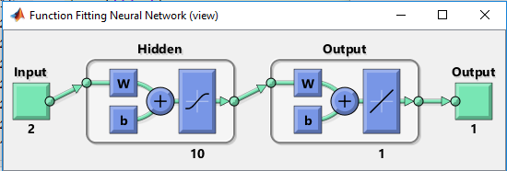
Example of ANN(1): (cont.)
MSE_testing=sum((tnew-Ynew).^2)/numel(tnew); % Calculate MSE for new data
RMSE_testing=sqrt(sum((tnew-Ynew).^2)/numel(tnew)); % Calculate RMSE for new data

Slide 16
Plotperform
Plottrainstate

Slide 17
Plotregression

Slide 18
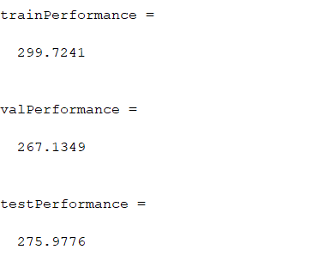
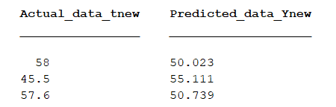
MSE_newdata=67.6933
RMSE_newdata=8.2278

Slide 19
Example of ANN, SVM, and NLR: (ANN)
clear;clc;
Filename='Datachemical.xlsx';
Sheetread='Training';
Input1='A1:C72';
output1='D1:D72';
Input=xlsread(Filename,Sheetread,Input1);
Target=xlsread(Filename,Sheetread,output1 );
x=Input;
t=Target;
Sheetread1=‘Newdata';
Input2='A1:C3';
Target2 ='D1:D3';
Inputnew=xlsread(Filename,Sheetread1,Input2);
Targetnew=xlsread(Filename,Sheetread1,Target2);

Slide 20
Example of ANN, SVM, and NLR :(ANN) (cont.)
xnew=Inputnew;
tnew=Targetnew;
x=Input';
t=Target';
xnew=Inputnew';
tnew=Targetnew';
trainFcn = 'trainlm'; hiddenLayerSize = 10;
net.layers{1}.transferFcn = 'logsig'; %for hidden layer
net = fitnet(hiddenLayerSize,trainFcn);
net.input.processFcns = {'mapminmax'}; % To standardize the input between -1 to 1.
net.output.processFcns = {'mapminmax'}; % To standardize the output -1 to 1
RandStream.setGlobalStream (RandStream ('mrg32k3a'));% Just to get the same results create random number streams;
net.divideMode = 'sample';

Slide 21
Example of ANN, SVM, and NLR: (ANN) (cont.)
net.divideParam.trainRatio = 70/100;
net.divideParam.valRatio = 20/100;
net.divideParam.testRatio = 10/100;
net.performFcn = 'mse'; % Choose MSE for performance
[net,tr] = train(net,x,t);
y = net(x);
e = gsubtract(t,y); %Generalized subtraction
performance = perform(net,t,y);
figure;plotperform(tr)
figure;plottrainstate(tr) %Plot training state valuesfigure, plotregression(t,y) % Regression plot
trainTargets = t .* tr.trainMask{1}; % Apply a mask (0's and 1's to select the proper targets) to select train data

Slide 22
Example of ANN, SVM, and NLR: (ANN) (cont.)
valTargets = t .* tr.valMask{1}; %Select validation data
testTargets = t .* tr.testMask{1}; %select test data
trainPerformance = perform(net,trainTargets,y) % training data performance
valPerformance = perform(net,valTargets,y) % validation data performance
testPerformance = perform(net,testTargets,y) %test data performance
Ynew=net(xnew); %Test the net with new data to calculate the performance and make predictions.
Newperformance=mse(tnew,Ynew); %MSE for new data
table( tnew( 1: 10)',Ynew( 1: 10)', 'VariableNames',
{'Actual_data_tnew',' Predicted_data_Ynew'}) % Prediction of tnew and Ynew for first 10th data

Slide 23
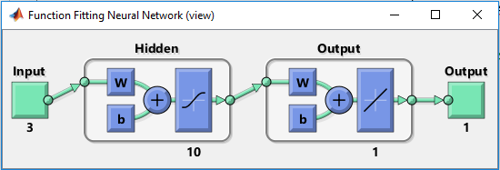
Example of ANN, SVM, and NLR: (ANN) (cont.)
MSE_testing=sum((tnew-Ynew).^2)/numel(tnew); % Calculate MSE for new data
RMSE_testing=sqrt(sum((tnew-Ynew).^2)/numel(tnew)); % Calculate RMSE for new data
Errorpercentage=((Ynew-tnew)./tnew)*100; % Calculate error percentage for tnew and ynew

Slide 24
Plotperform
Plottrainstate

Slide 25
Plotregression

Slide 26
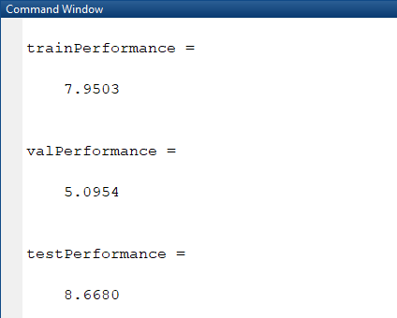
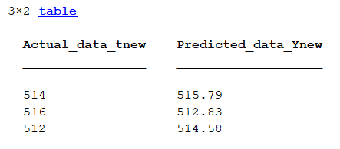
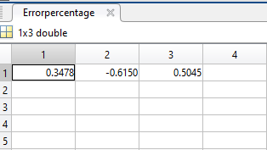
MSE_newdata=6.6460
RMSE_newdata=2.5780

Slide 27
Example of ANN, SVM, and NLR: (SVM) (cont.)
clear;clc;
Filename='Datachemical.xlsx';
Sheetread='Training';
Input1='A1:C72';
output1='D1:D72';
Input=xlsread(Filename,Sheetread,Input1);
Target=xlsread(Filename,Sheetread,output1 );
x=Input;
t=Target;
Sheetread1='Newdata';
Input2='A1:C3';
Target2 ='D1:D3';

Slide 28
Example of ANN, SVM, and NLR: (SVM) (cont.)
Inputnew=xlsread(Filename,Sheetread1,Input2);
Targetnew=xlsread(Filename,Sheetread1,Target2 );
xnew=Inputnew;
tnew=Targetnew;
mdl = fitrsvm(x,t,'KernelFunction', 'gaussian', ...
'Standardize', true); %standardize the data %standardize the data and
conv = mdl.ConvergenceInfo.Converged; % Shows whether the program reach an answer or not .
% smetimes it cannot find a solution and doesnot converge
iter = mdl.NumIterations; % number of iteration to reach the answer

Slide 29
Example of ANN, SVM, and NLR: (SVM) (cont.)
yfit=predict(mdl,x); % prediction based on the developed SVR model and x as the input
table(t(1:10,:),yfit(1:10,:),'VariableNames',{'ObservedValue',' PredictedValue'}) % show 20th to 30th data in output and predicted output
MSE_training=sum((yfit-t).^2)/numel(t); % Calculate MSE for data
% MSE_training1=mse(yfit,t);
RMSE_training=sqrt(sum((yfit-t).^2)/numel(t)); % Calculate RMSE for data
ynew=predict(mdl,xnew);
table(tnew(:),ynew(:),'VariableNames',{'ObservedValue_Newdata',' PredictedValue_newdata'}) % show data in output and predicted output
% MSE_testing1=mse(tnew,ynew);

Slide 30
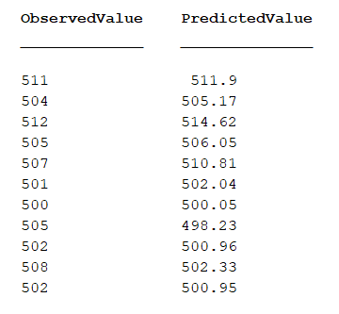
Example of ANN, SVM, and NLR: (SVM) (cont.)
MSE_testing=sum((tnew-ynew).^2)/numel(tnew); % Calculate MSE for new data
RMSE_testing=sqrt(sum((tnew-ynew).^2)/numel(tnew)); % Calculate RMSE for new data
Errorpercentage=((ynew-tnew)./tnew)*100; % Calculate error percentage for tnew and ynew

Slide 31
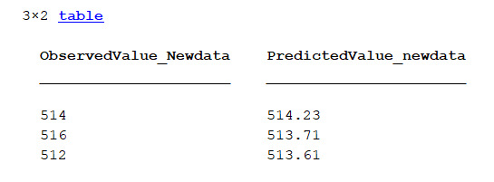
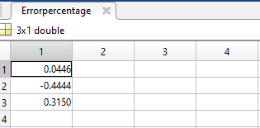
Example of ANN, SVM, and NLR: (SVM) (cont.)
MSE_training =5.7400
MSE_testing =2.6371
RMSE_training =2.3958
RMSE_testing =1.6239

Slide 32
Example of ANN, SVM, and NLR: (NLR)
clear;clc;
Filename='Datachemical.xlsx';
Sheetread='Training';
Input1='A1:C72';
output1='D1:D72';
Input=xlsread(Filename,Sheetread,Input1);
Target=xlsread(Filename,Sheetread,output1 );
x=Input;
t=Target;
Sheetread1='Newdata';
Input2='A1:C3';
Target2 ='D1:D3';
Inputnew=xlsread(Filename,Sheetread1,Input2);
Targetnew=xlsread(Filename,Sheetread1,Target2 );

Slide 33
Example of ANN, SVM, and NLR: NLR (cont.)
xnew=Inputnew;
tnew=Targetnew;
[xn,sxn] = mapminmax(x');% Standardize x
[tn,stn]= mapminmax(t');% Standardize t
xnewn = mapminmax('apply',xnew',sxn); % The same Process setting of
%standardization for x should be applied for xnew as well .%xnewn is the
%standardized xnew
xn=xn';% standardized x
tn=tn';% standardized t

Slide 34
Example of ANN, SVM, and NLR: NLR (cont.)
xnewn=xnewn';%standardized xnew
beta = [1 1 1 1 1 1 1 1]; % coefficient initiation
fun=@(b,xn)b(1)+b(2)*xn(:,1)+b(3)*xn(:,2)+b(4)*xn(:,3)+b(5)*(xn(:,1).^2)+b(6)*((xn(:,1).*xn(:,2).*xn(:,3))+b(7).*exp(b(8)*xn(:,3)));% nonlinear model with standardized x
mdl = fitnlm(xn,tn,fun,beta);% find coeffcients(beta) of model(fun )using normalized x and t
yfitn = predict(mdl,xn);% make prediction based on normalized x
yfit = mapminmax('reverse', yfitn,stn); % To reverse the prediction to original state using the same process setting of t
table( t( 40:50 ),yfit( 40:50 ), 'VariableNames',...
{' TrueLabel',' PredictedLabel'}) %Show the results of 40th to 50th

Slide 35
Example of ANN, SVM, and NLR: NLR (cont.)
MSE_training=sum((yfit-t).^2)/numel(t); % Calculate MSE for data
RMSE_training=sqrt(sum((yfit-t).^2)/numel(t)); % Calculate RMSE for data
ynewn=predict(mdl,xnewn);% make prediction based on normalized new data
ynew = mapminmax('reverse', ynewn,stn); % To reverse the normalized ynew and use the processing setting of t
table(tnew(:),ynew(:),'VariableNames',{'ObservedValue_Newdata',' PredictedValue_newdata'}) % show data in output and predicted output
MSE_testing=sum((tnew-ynew).^2)/numel(tnew); % Calculate MSE for new data
RMSE_testing=sqrt(sum((tnew-ynew).^2)/numel(tnew)); % Calculate RMSE for new data
Errorpercentage=((ynew-tnew)./tnew)*100; % Calculate error percentage for tnew and ynew

Slide 36
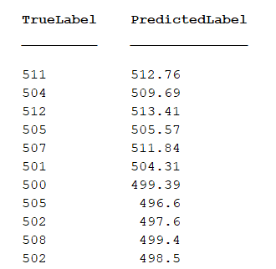
MSE_training =10.1974
MSE_testing =5.6746
RMSE_training =3.1933
RMSE_testing =2.3821

Slide 37
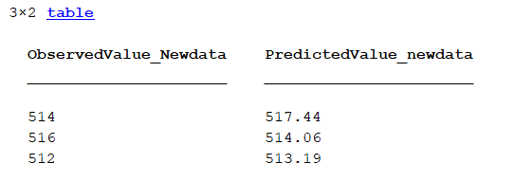
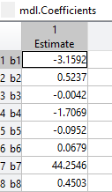
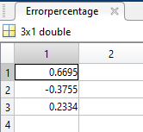

Slide 38
ANN
MSE_training =7.9503
MSE_testing =8.6680
SVR
MSE_training =5.7400
MSE_testing =2.6371
NLR
MSE_training =10.1974
MSE_testing =5.6746

